Slide 1
Text Representation from Text to Neural Network
楊家融 |  | 台東馬偕放射科 成大資工

Slide 2
Charactor encoding

Slide 3

Bag of Words
 | I | Love | Dogs
Doc 1 | 1 | 1 | 1
I love dogs

Slide 4

Bag of Words

Slide 5
5

Slide 6

and
passion

Slide 7




Slide 8
銀蘋果
對於這袋子
有多重要？

Slide 9
1/10000
1/1000
998.9/1000

Slide 10
銀蘋果
紅蘋果

Slide 12
Word embedding

Slide 13


keras.layers.Embedding
passion
x: 0.119
y: 0.212
z: 0.010
1

Slide 14
panda
cat
dog
goat
pig
hamster

Slide 15
Word2Vec
panda
cat
goat
dog
pig
hamster

Slide 16
Word2Vec
Queen
King
Woman
Man

Slide 17
“ The quick brown fox _____ over the lazy dog ”
?
kicks
shots
throws
looks
jumps

Slide 18
“ The quick brown fox _____ over the lazy dog ”

Slide 19
quick
brown
fox
over
the
lazy
Hidden
0.0010
0.0000
0.0034
0.2421
0.0000
0.0000
0.0000
.
.
.
.
.
.

Slide 20
quick
brown
fox
over
the
lazy
Hidden
jumps
CBOW
Continuous bag-of-words

Slide 21
Hidden
quick
brown
fox
over
the
lazy
jumps
Skip-gram
Continuous skip-gram

Slide 22
Dimension coordination
Probability list
0.0010
0.0000
0.0034
0.2421
0.0000
0.0000
0.0000
.
.
.
.
.
.

Slide 23
“ The quick brown fox _____ over the lazy dog ”
grammatical, semantical similarity
Notes:
grammar

Slide 24
Word Embedding Choices
Learnable embedding
Word2Vec
GloVe
FastText

Slide 25
Homework Estimate the time for training the word2vec model with today’s English Wikipedia on your computer

Slide 26
Word2Vec
Check genism
Get the training data on the same page (text8)
https://radimrehurek.com/gensim/models/word2vec.html

Slide 27
Text8 Large text compression benchmark
First 10⁹ bytes of the English Wikipedia dump on Mar. 3, 2006.
Remove tags, digits, punctations
Lower cases
Leaving a-z, unrepeated spaces
Truncate first 10⁸ bytes
About 1700 articles
http://mattmahoney.net/dc/textdata.html

Slide 28
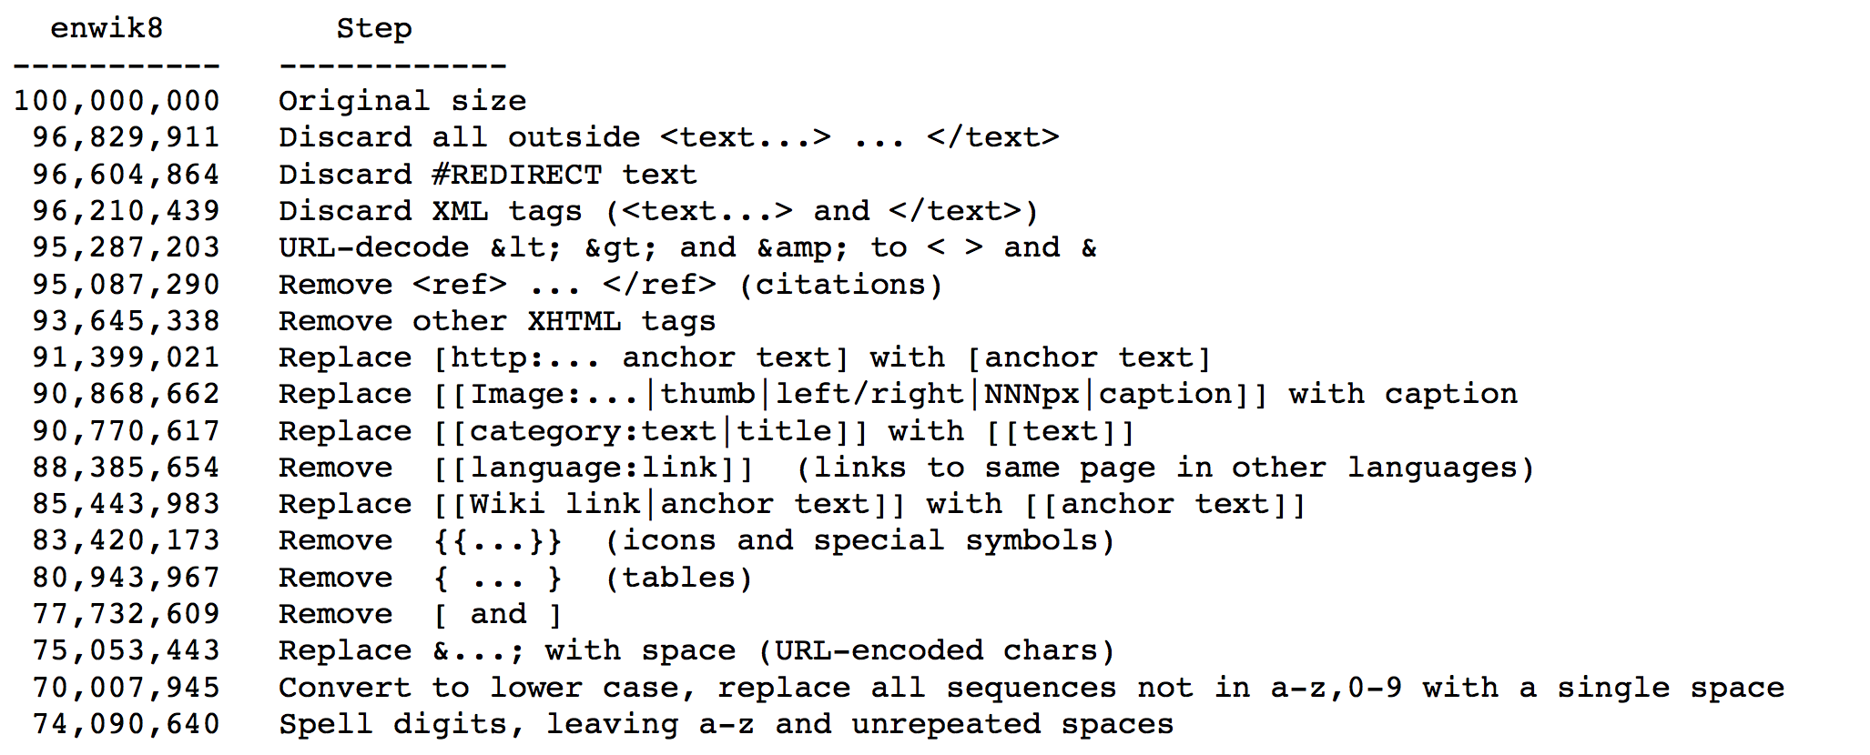

Slide 29
$$O=E×T×Q$$
O Training complexity
E Training epochs
T Word count in corpus
Q <Model related factor>

Slide 30
$$O=E×T×Q$$
O Training complexity
E Training epochs
T Word count in corpus
Q <Model related factor>
CBOW
Continuous bag-of-words
N Window size for input
D Dimension of P layer
V Size of vocabulary
$$Q=N×D+D×\log_{2}\left(V\right)$$

Slide 31
$$O=E×T×Q$$
O Training complexity
E Training epochs
T Word count in corpus
Q <Model related factor>
Skip-gram
Continuous skip-gram
C Maximum word distance
D Dimension of P layer
V Size of vocabulary
$$Q=C×\left(D+D×\log_{2}\left(V\right) \right)$$

Slide 32
Word count
Try Wikipedia Statistics page https://en.wikipedia.org/wiki/Wikipedia:Size_in_volumes

Slide 33
Vocabulary size
Try Heaps' law
https://en.wikipedia.org/wiki/Heaps%27_law

Slide 34
Homework
Time used on your computer to train with text8
How to estimate the time used on your computer to train with full English Wikipedia
楊家融 |  | Radiologist Programmer

